Slide 1
Intro to Coding with Python– Recursion Pt 2
Dr. Ab Mosca (they/them)
Slides based off slides courtesy of Jordan Crouser (https://jcrouser.github.io/)

Slide 2
Plan for Today
Tough problems, simple solutions
More Recursion & Recursive Functions
Finding the Largest in a List
Finding the Smallest in a List
Traversing a Maze
Fractal Trees

Slide 3
Basic structure of a recursive algorithm
A base case: what to do in the simplest possible case (i.e. when you have a single disk)
A recursive step: break the original problem into one or more smaller problems, and solve that (saving the intermediate result)

Slide 4
Recursion themes
“Looping without a loop”
“A function that calls itself as part of its definition”
“Solving a problem by solving smaller instances”
Key components of all three:
a recursive step (i.e. knowing when to split)
a “base case” (i.e. knowing when to stop)

Slide 5
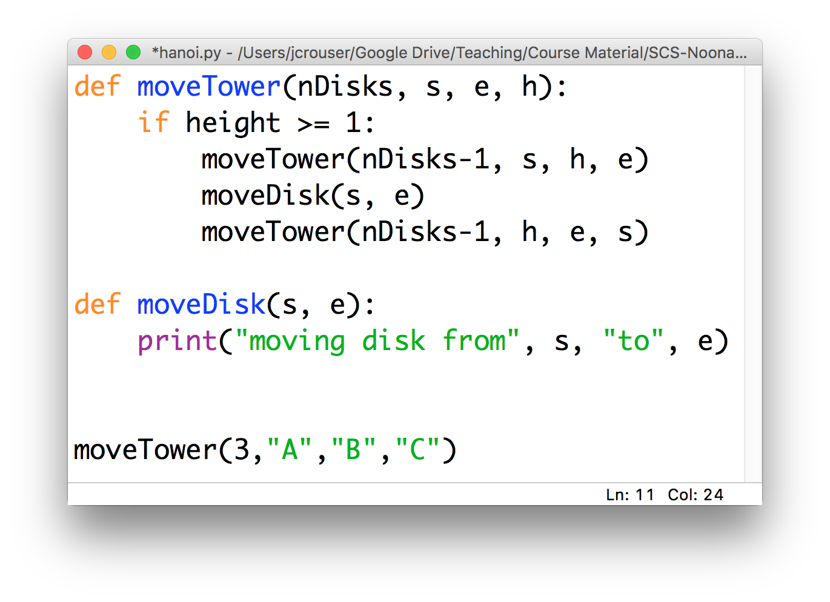
Recap: recursive functions (Hanoi)

Slide 6
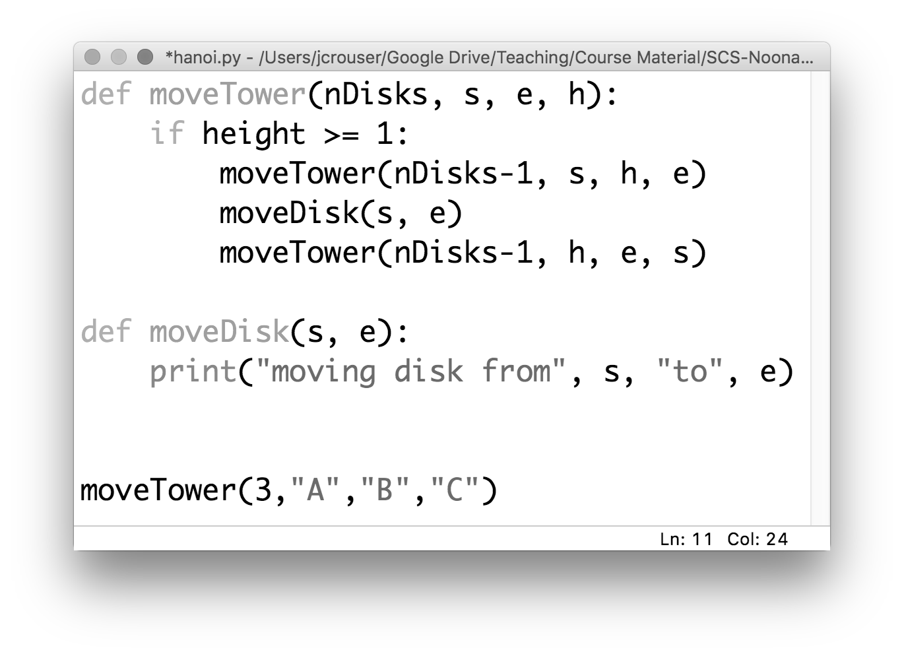
Recap: recursive functions (Hanoi)

Slide 7
Discussion
What actually happens in memory
when you call a function?

Slide 8
the “stack”
the program
in memory
def f1(a):
y = f2(a+1)
return y
def f2(b):
z = b
if (z > 2):
z = z/2
return b^2
f1(3)

Slide 9
the “stack”
the program
in memory
def f1(a):
y = f2(a+1)
return y
def f2(b):
z = b
if (z > 2):
z = z/2
return b^2
f1(3)

Slide 10
the “stack”
the program
in memory
def f1(a):
y = f2(a+1)
return y
def f2(b):
z = b
if (z > 2):
z = z/2
return b^2
f1(3)
f1(3): y

Slide 11
the “stack”
the program
in memory
def f1(a):
y = f2(a+1)
return y
def f2(b):
z = b
if (z > 2):
z = z/2
return b^2
f1(3)
f1(3): y

Slide 12
the “stack”
the program
in memory
def f1(a):
y = f2(a+1)
return y
def f2(b):
z = b
if (z > 2):
z = z/2
return b^2
f1(3)
f2(4): z
f1(3): y

Slide 13
the “stack”
the program
in memory
def f1(a):
y = f2(a+1)
return y
def f2(b):
z = b
if (z > 2):
z = z/2
return b^2
f1(3)
f1(3): y

Slide 14
the “stack”
the program
in memory
def f1(a):
y = f2(a+1)
return y
def f2(b):
z = b
if (z > 2):
z = z/2
return b^2
f1(3)
…whatever’s next!

Slide 15
Discussion
What actually happens in memory
when you call a function
recursively?

Slide 16
the “stack”
the program
in memory
def f3(a):
if (a == 1):
return 1
else:
x = f3(a-1)+1
f3(100)
…
f3(97): x
f3(98): x
f3(99): x
f3(100): x
…but isn’t there limited space?

Slide 17
Demo: recursive addition
Notes:
Sum numbers in a list using recursion

Slide 18
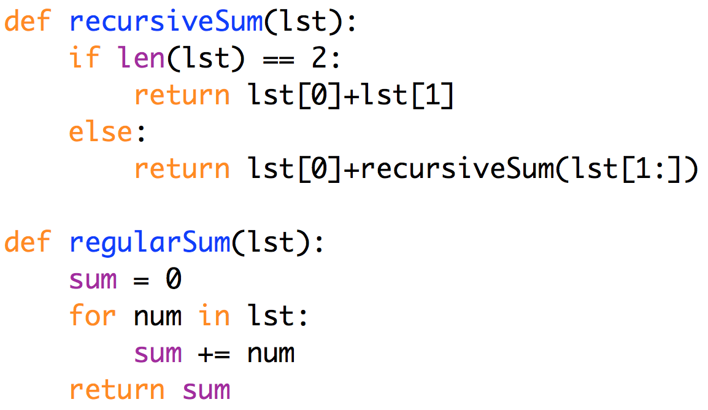
Recursive vs. iterative addition
in this case,
the iterative solution
feels cleaner
Notes:
Anything you can write recursively, you can also write iteratively. This avoids the issue of having to duplicate all the local variables, etc. and so poof! No more recursion depth issues.
Moreover, some problems just seem to make more sense as a loop.

Slide 19
Discussion
How would you solve Tower of Hanoi iteratively?
Notes:
It’s always the case that you CAN rewrite recursive code as iterative code. But it isn’t always pretty.
It’s really hard to describe, right?

Slide 20
More problems with recursive solutions
15 minute (non-programming) Challenge:
How would you program a robot to solve a maze?

Slide 21
A recursive solution
Mark your current location as visited
If you’re at the end, you’re done!
If not:
If unmarked, go NORTH, solve maze. If not solved, go back and:
If unmarked, go SOUTH, solve maze. If not solved, go back and:
If unmarked, go EAST, solve maze. If not solved, go back and:
If unmarked, go WEST, solve maze. If not solved, NO SOLUTION

Slide 22
Clever recursion allows backtracking!
Mark your current location as visited
If you’re at the end, you’re done!
If not:
If unmarked, go NORTH, solve maze. If not solved, go back and:
If unmarked, go SOUTH, solve maze. If not solved, go back and:
If unmarked, go EAST, solve maze. If not solved, go back and:
If unmarked, go WEST, solve maze. If not solved, NO SOLUTION

Slide 23
Discussion
What is the
most confusing thing
about recursion?

